Slide 1


Advancing digital technology for urban nature
John Tweddle, Ed Baker, Sumera Saad
Notes:
Good afternoon and thank you for joining us for this session in which we’ll introduce some of the ways that we’re developing and employing digital technologies to monitor and support recovery of the UK’s urban nature

Slide 2
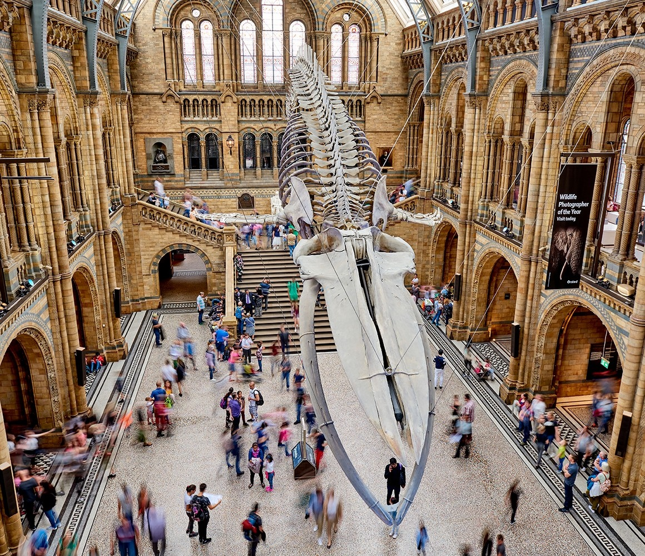
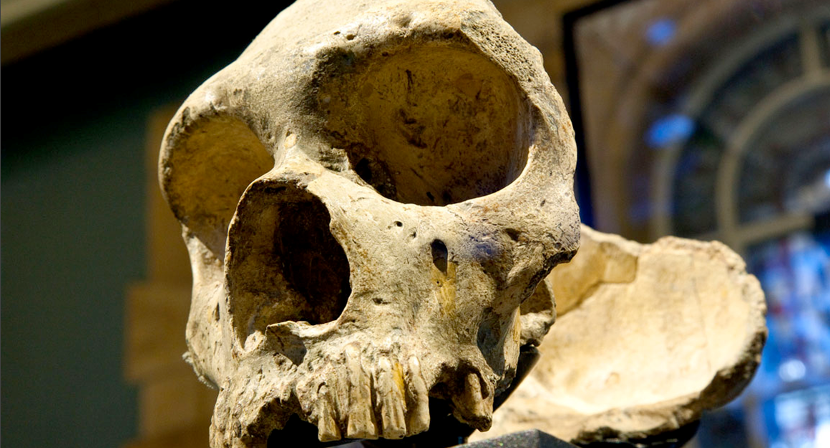
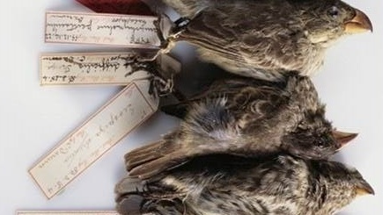
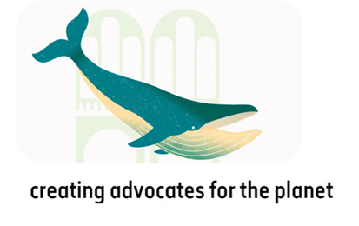
Notes:
I’m John Tweddle and along with Ed Baker I’m based at the NHM in London, where I’m a conservation biologist and head of the Centre for UK Nature
You perhaps know the Museum best as a visitor attraction – have maybe visited yourselves on a school trip or as an adult – and we welcome over 5 million people to our sites annually, more online
We run active science communication and school education programmes, but what is perhaps less well known is that we are also home to over 400 scientists and Ed and I are part of that team.
Our collection spans over 80 million specimens that chart the origins of the solar system and the evolution and diversity of life on earth. These specimens form an incredibly data-rich resource that is enabling us to track and study how the world’s nature and environment has changed through time, model predicted changes into the future and inform the steps that we can take to protect it.
The focus of the organisation is on tackling the joint planetary emergency of climate change and biodiversity loss by developing solutions from and for nature and creating advocates for the planet – people with the awareness and agency to take positive steps to deliver a brighter future for nature and people
Embracing nature tech is a key part of the solution

Slide 3
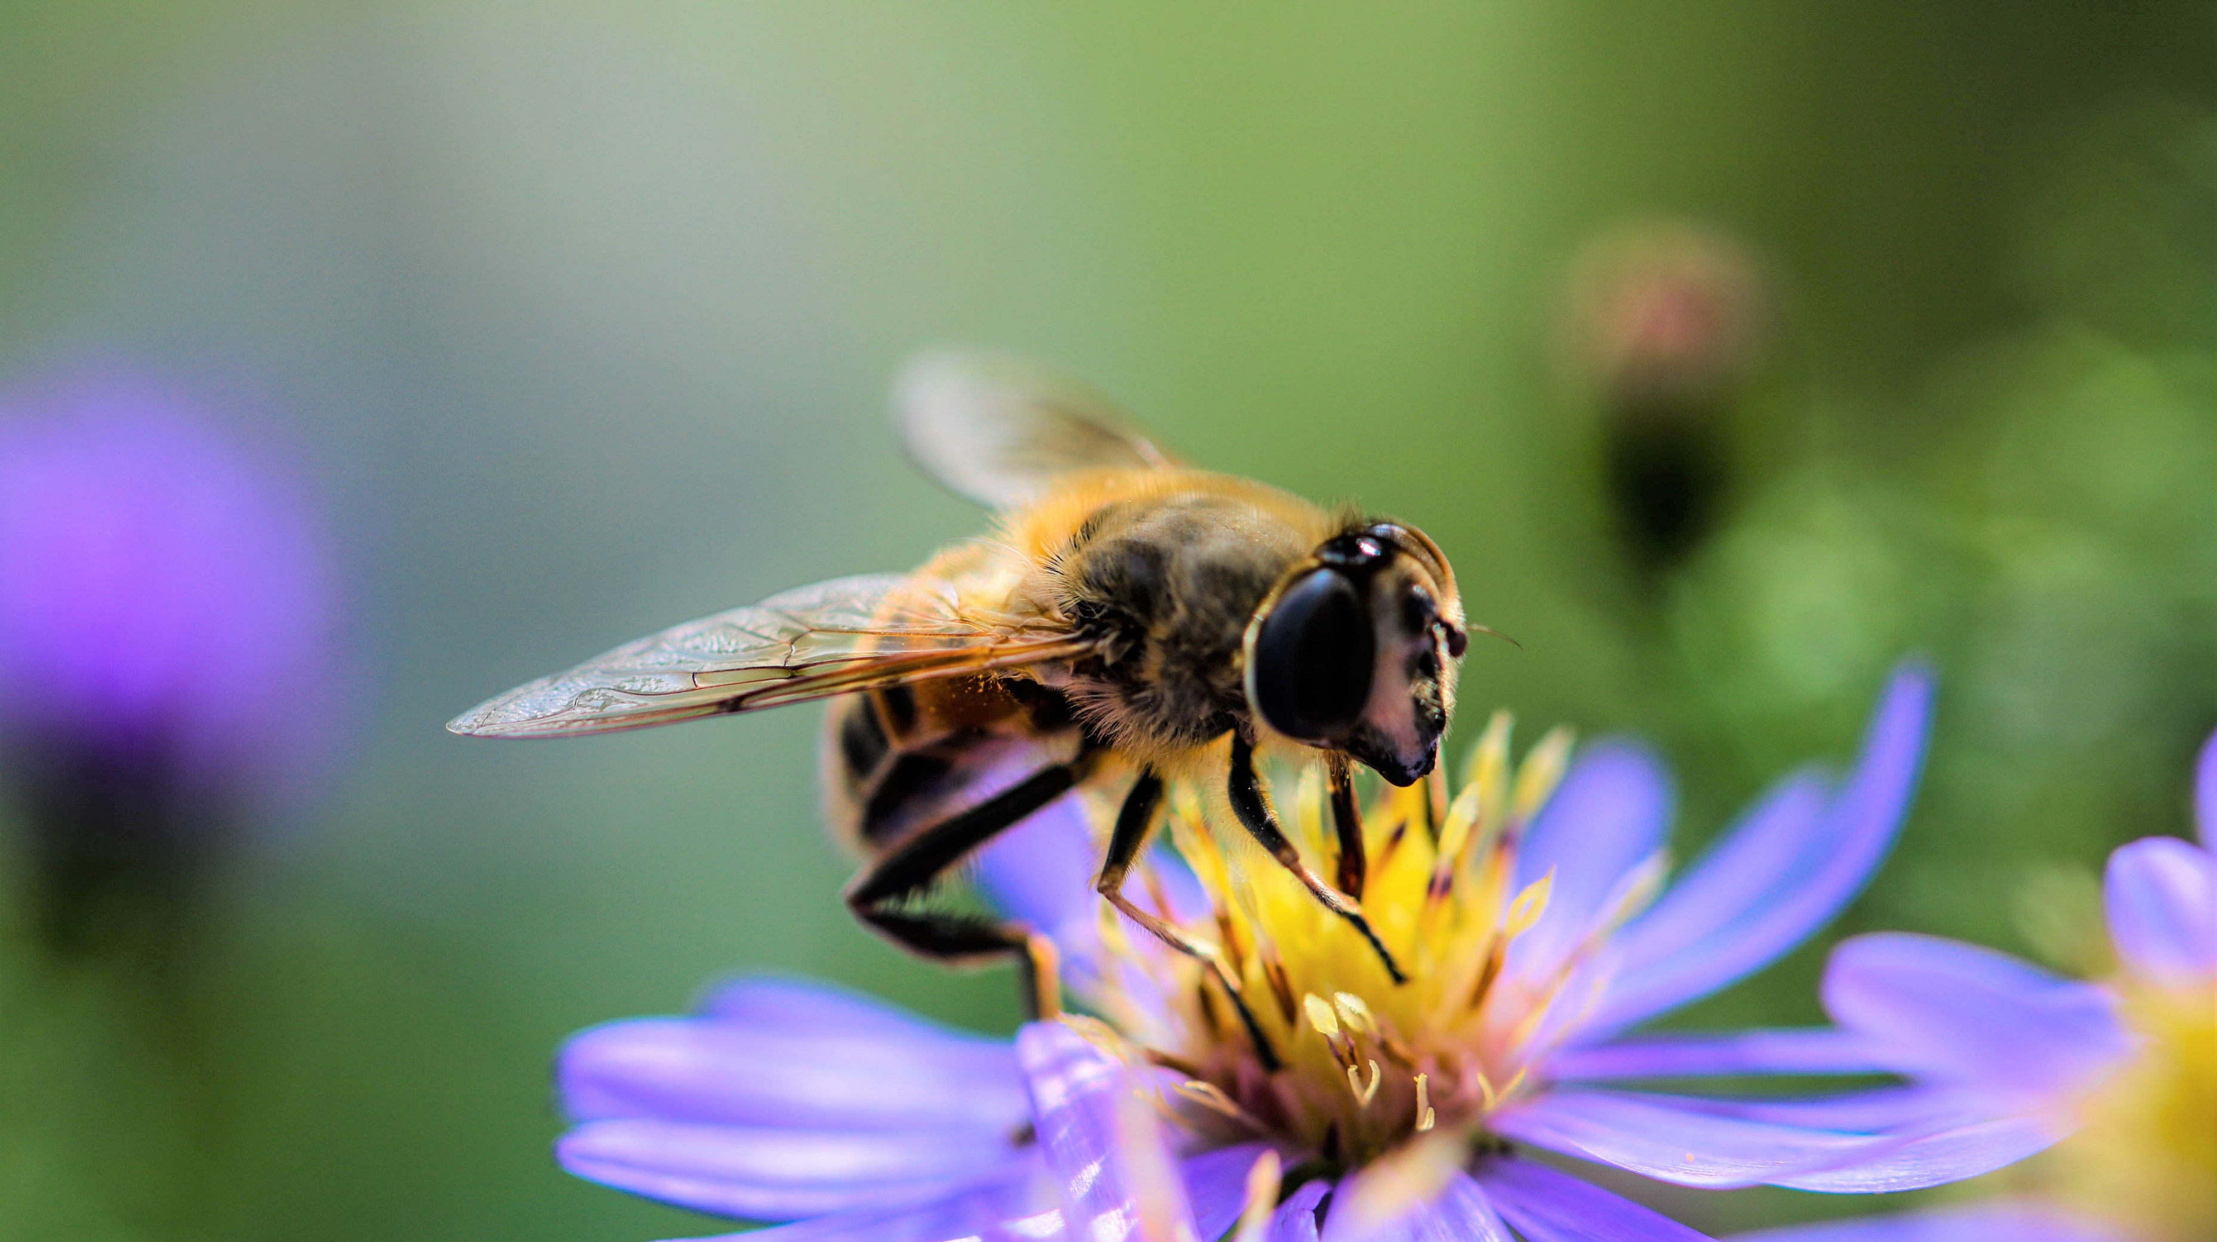
How can we work with our audiences and partners to progress evidence-led recovery of the UK’s nature?
Nature Tech is fundamental to our approach
Notes:
A significant element of our work focuses on how we can actively progress data-led recovery of nature here in the UK.
The UK has some of the most depleted nature in the world and a large proportion of species and habitats are in decline. And this matters – the nature that surrounds us is essential to our existence and ways of life, from pollinating many of our food crops, purifying air and water. Through to helping to mitigate the impacts of global climate change through carbon storage, flood resilience.
And we also know that spending time in nature confers direct mental and physical wellbeing benefits

Slide 4
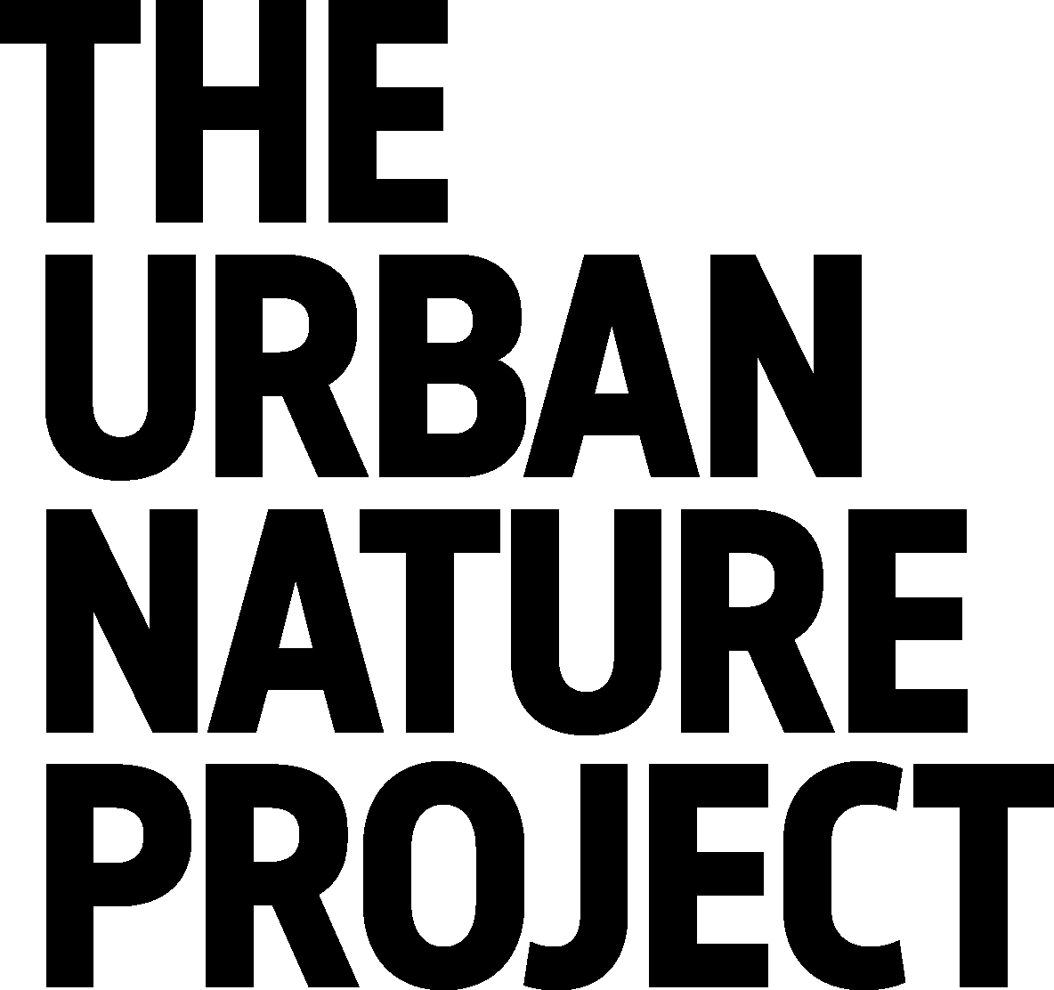


Notes:
And today we wanted to introduce one of our most ambitious programmes that aims to inspire a connection with nature and progress UK nature recovery
It’s called the Urban Nature Project and is a programme that is led by the NHM in collaboration with a UK-wide partnership of cultural organisations and conservation charities. To underpin the science outputs of the project we are creating a Data Ecosystem powered by AWS technology

Slide 5
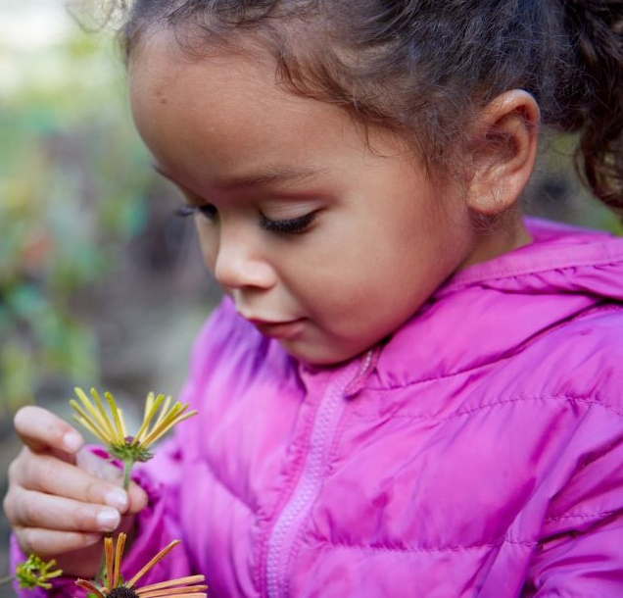
92% of UK population predicted to be urban by 2030.
Creating a new movement of people and communities that have the agency to take data- informed action for urban nature.
It’s not too late to help the nature on your doorstep.
CONFIDENTIAL
© The Trustees of the Natural History Museum, London
Notes:
Urban centres can be challenging places to live in for nature and people alike. We know that habitats can be fragmented and disturbed and also that the disconnect between people and nature (and wellbeing benefits we receive from nature) can be greatest in these areas. But they are also where we’re most likely to interact with nature and we know that if you care about something you are more likely to take steps to protect it

Slide 6
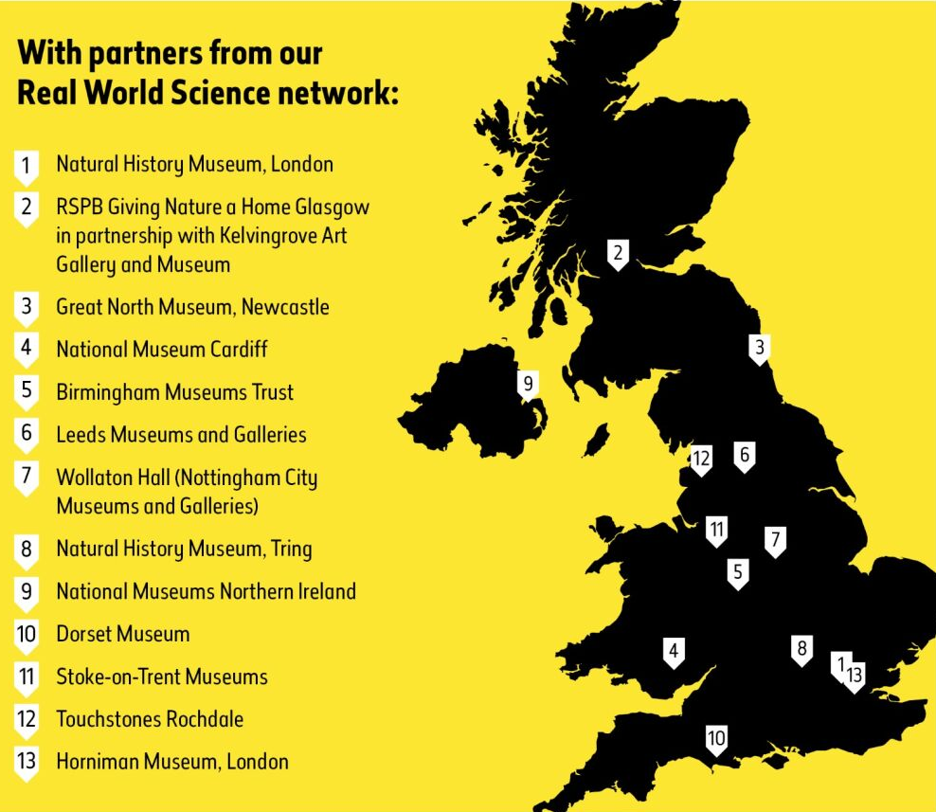
Connecting people to nature, building green skills
Developing scientific tools, data and skills to monitor and enhance urban nature
Transforming the Museum’s five-acre gardens into a biologically diverse living lab
Notes:
To tackle these challenges, we are working with a network of Museums across the UK – shown here on this map to develop:
opportunities for young people, families and schools to connect with and learn about their local nature and then take nature-positive actions
Training that supports young people to develop green skills
and scientific research, tools and networks to help better understand urban biodiversity and support evidence-informed actions that help nature recover
As part of this work we are transforming the Museum’s gardens into an outdoor gallery and living laboratory

Slide 7
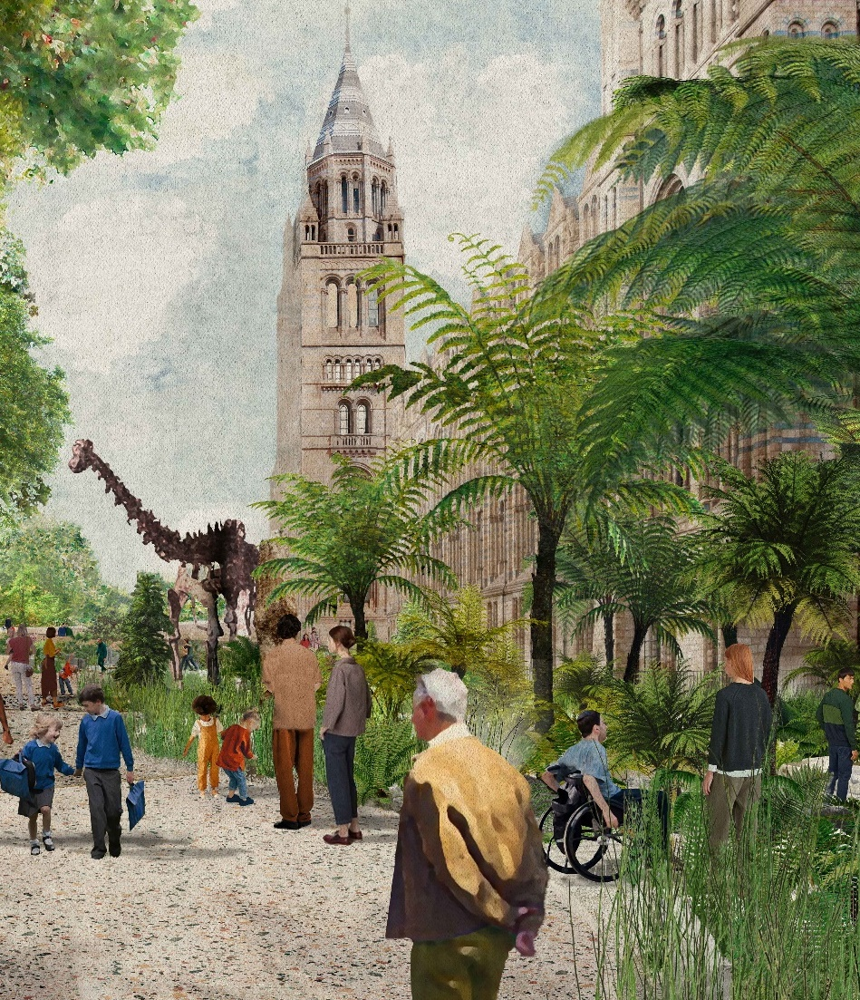
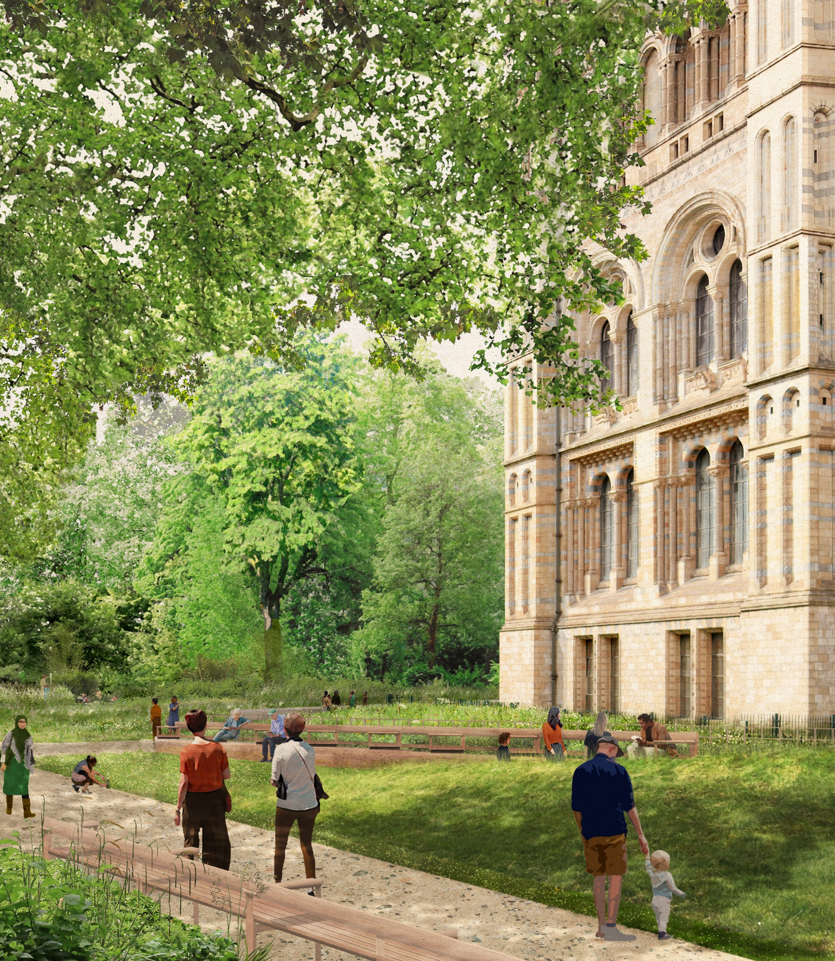
Notes:
So let’s start on our own doorstep. We are currently redeveloping the 5 acres of space that surround the Museum – new gardens will open next month and for the first time since we opened in 1881 they’ll form a coherent visitor experience
The garden focuses on change at different scales, starting with our new evolution garden that will immerse our visitors in processes of natural change – a walk through 500 million years of evolution of life on land up to the current epoch – the Anthropocene within which humans have had such widescale impacts.
As we move past the main museum entrance our visitors will enter the nature discovery garden. This has a very different look and feel. We will be encouraging visitors to slow down and explore present day urban wildlife. To reflect on their connection with nature and explore the roles that they can play in supporting its future. We know that this is something that our audience are keen to do.
Planting scheme comprises typical native habitats that can thrive in this highly urban central London location – different types of grassland and woodland and park-style planting and a network of ponds. It doubles the size of our existing wildlife garden and showcases how different scales of intervention can support wildlife.
Just out of sight will be an area focusing on urban nature in a changing climate – which will have a more mediterranean feel – along with a local community garden.

Slide 8
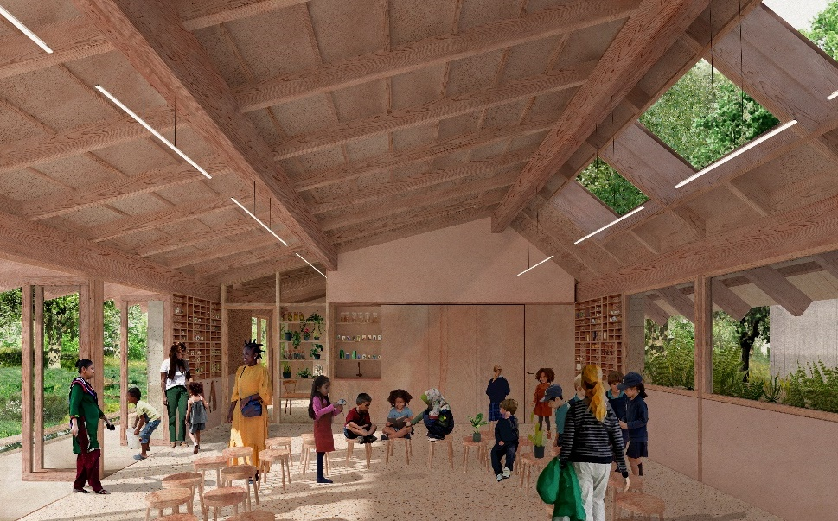
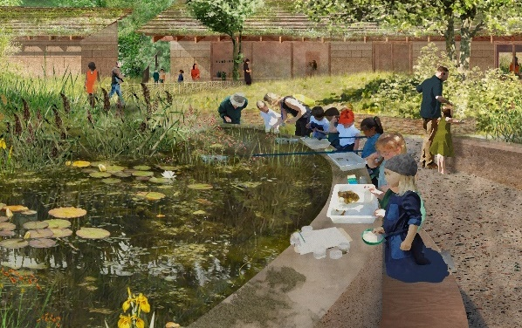
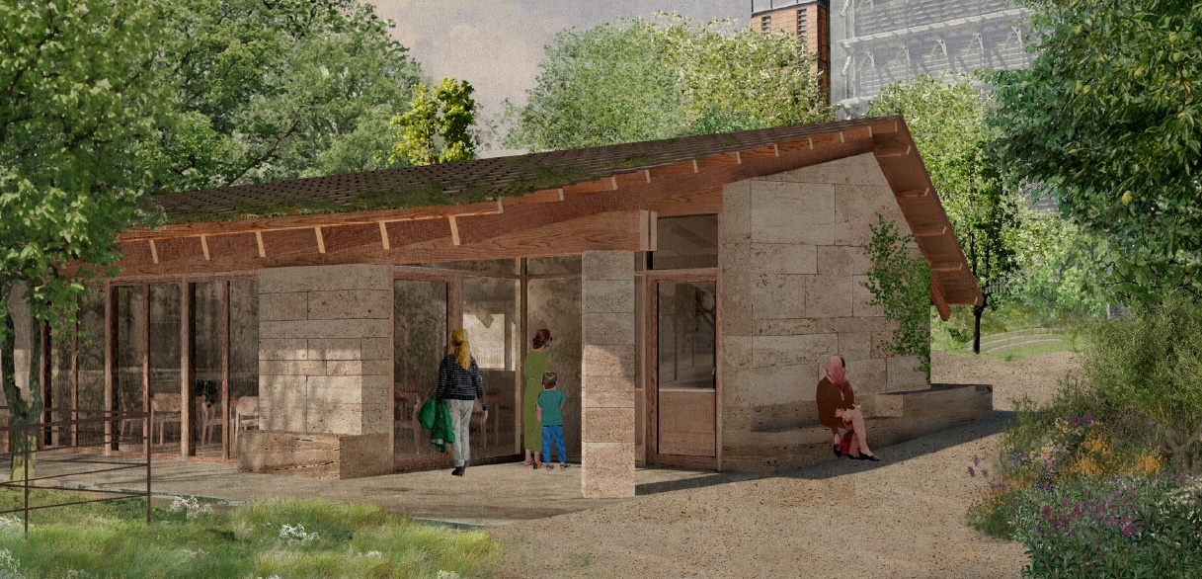
New Nature Activity Centre supported by AWS for year-round learning and science training, digital view of nature in our garden
Notes:
This area of our gardens will also include a new teaching and activity centre sponsored by AWS that will increase our capacity to deliver outdoor education to school pupils and adult learners. The building is sensitively designed to fit with the landscape and will contain a classroom, a science lab and space for our garden volunteers. Digital display

Slide 9
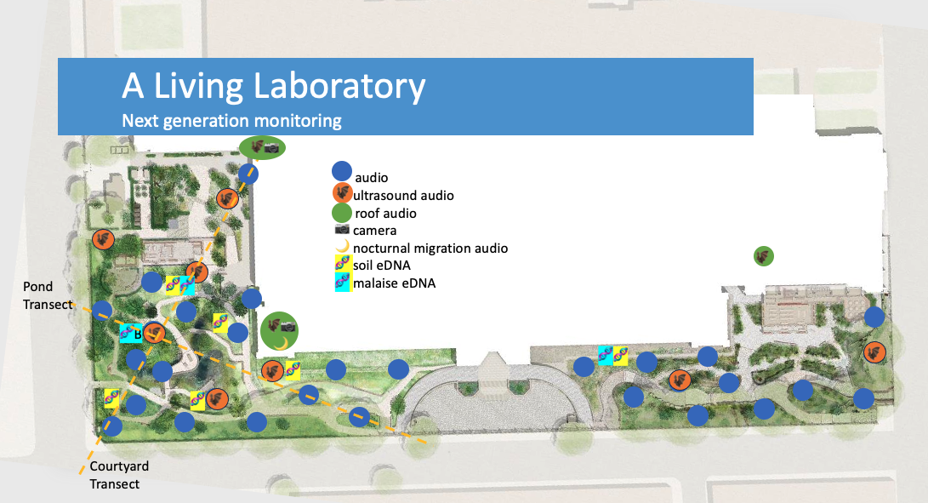
Notes:
Sensor network and in-depth monitoring transects are key – holistic picture
The aspect of the gardens we wanted to focus on today though is that it will form a collaborative hub for urban biodiversity monitoring and nature recovery research
The site will be a living laboratory where we can study urban nature and environment, including how our garden biodiversity changes seasonally and over longer timescales. It will be somewhere where we can test new methods and directly engage visitors in our science.
The intention is to build a holistic (digital) picture of the wealth of biodiversity and structure of the environment across the site, which will become one of the most active urban research stations globally.
Will now spend a few minutes unpicking how were applying nature tech in these different ways
And over the past 5 years have been developing
To facilitate this research we are including a power and data-web buried beneath the surface across the whole site from which we can attach an array of environmental sensors, measure sounds and photosynthesis levels and air pollution for example.

Slide 10
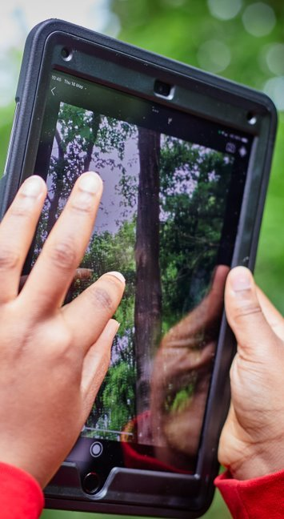

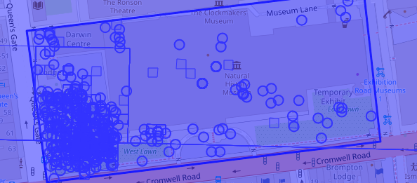

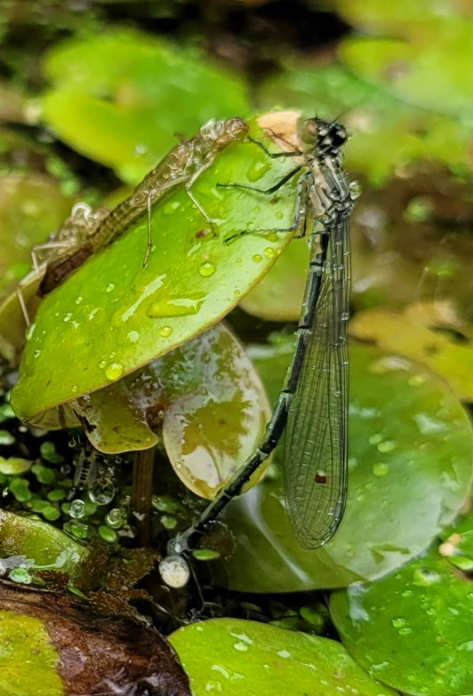
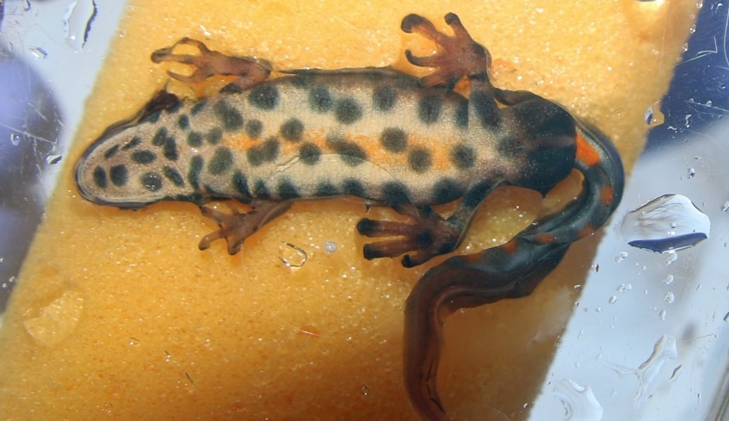
Visual observations
Notes:
50,000 observations of 3,500 species
Using standard apps – iRecord and iNat to use existing tech and ensure data are accessible to others
Also developing novel methods – spot pattern recognition on common newts to track population size
Structured surveys of e.g. dragonflies and birds plus ad hoc observations by staff and volunteers

Slide 11
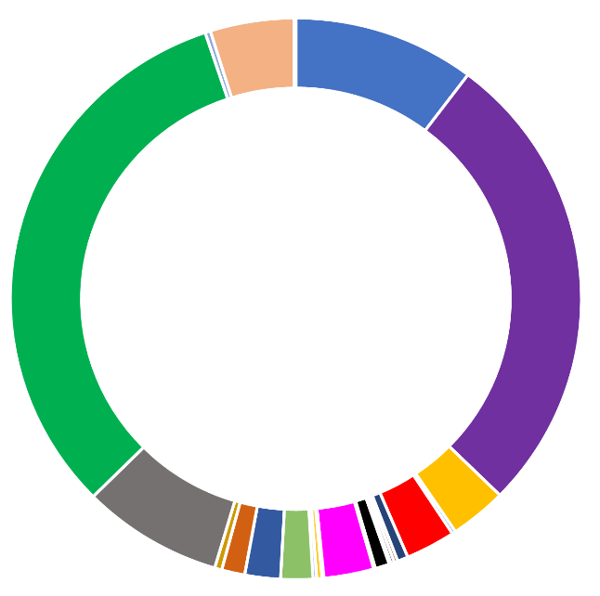
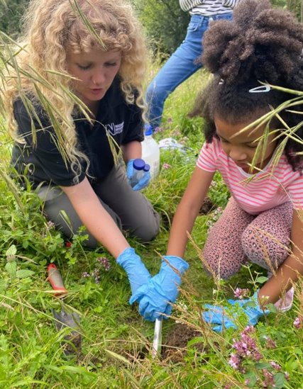
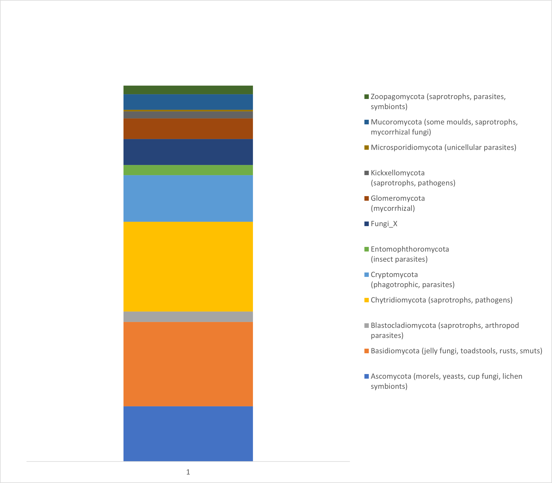
Environmental DNA – soil – water – airborne - surfaces
Soil bacterial communities
9,000 different types of organism found at just 6 London sites
Soil fungal communities
Notes:
Over past 5 years have been tailoring eDNA methods to chracterise urban envs and track change across a far wider range of species than can be done visually
Testing protocols and analytic pipelines for new eDNA methods – DNA shed within the environment
Rapid ecosystem assessment
Talk about the methods and scales of data – richness
What does good look like, how do we interpret the richness of data?

Slide 12
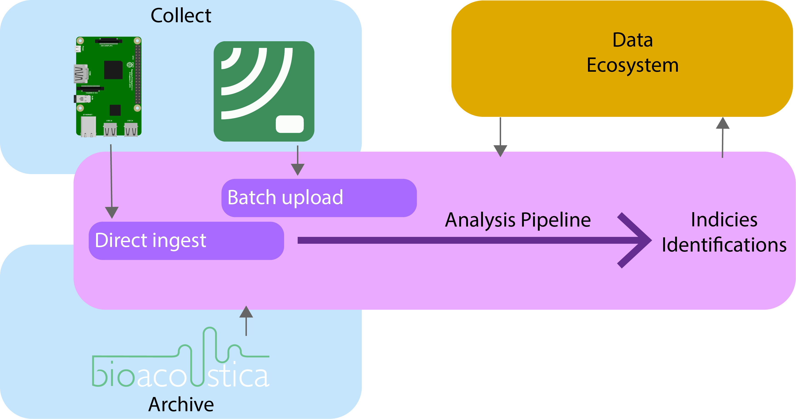
Acoustic + environmental sensors
soil – water – airborne – surfaces – within plants
Comprehensive survey of acoustic environments of the site:
Airborne (+ ultrasound); freshwater; soil; timber
Nocturnal migration (roof)
Spatial audio
One year complete dataset
Environmental sensors:
Temperature (urban heat island)
Humidity / light levels
Air pollution
….
Notes:
Run through acoustic work

Slide 13
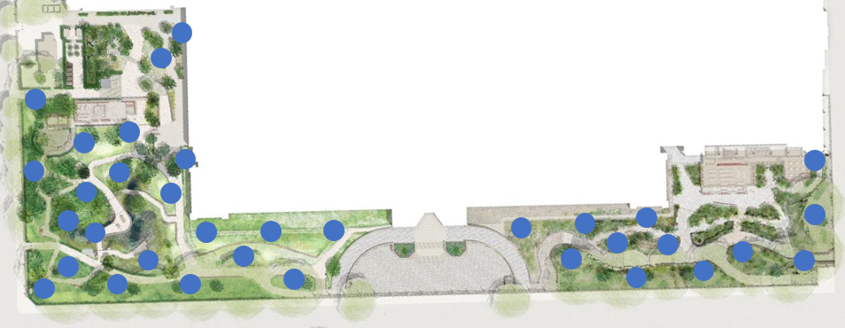
Sensor network
Permanent, integrated digital infrastructure
Spare capacity
Standard technologies
Platform for research
Goes beyond the gardens
Notes:
Talk through sensor network and how it can be used by others, plus how it is a model that can be extended at other locations

Slide 14
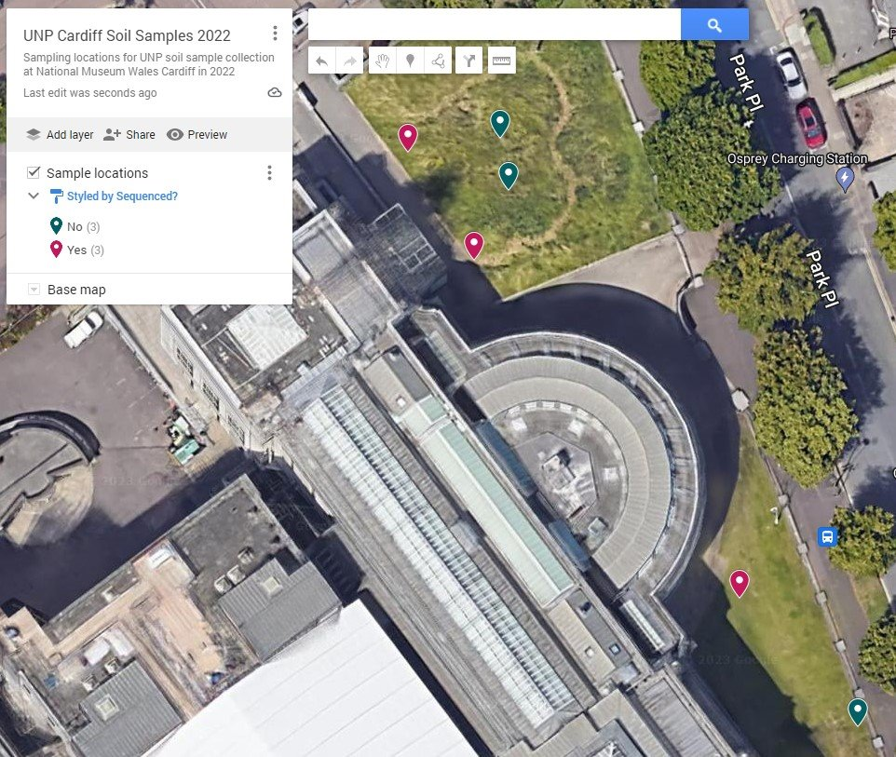
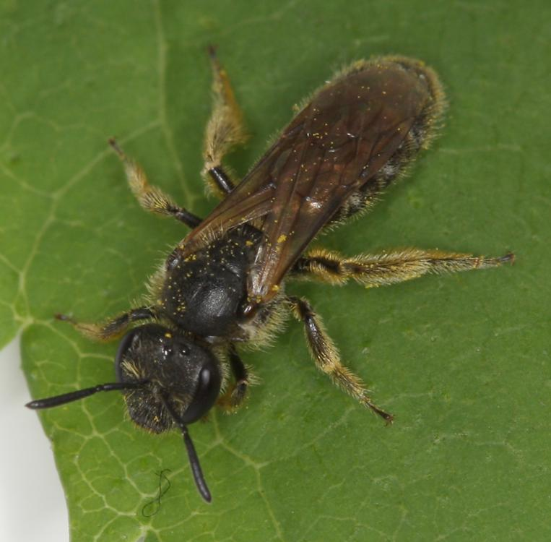
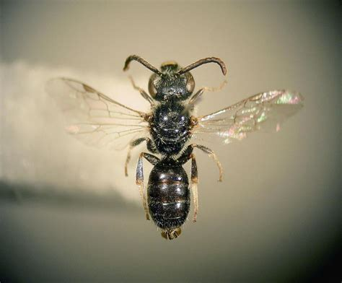
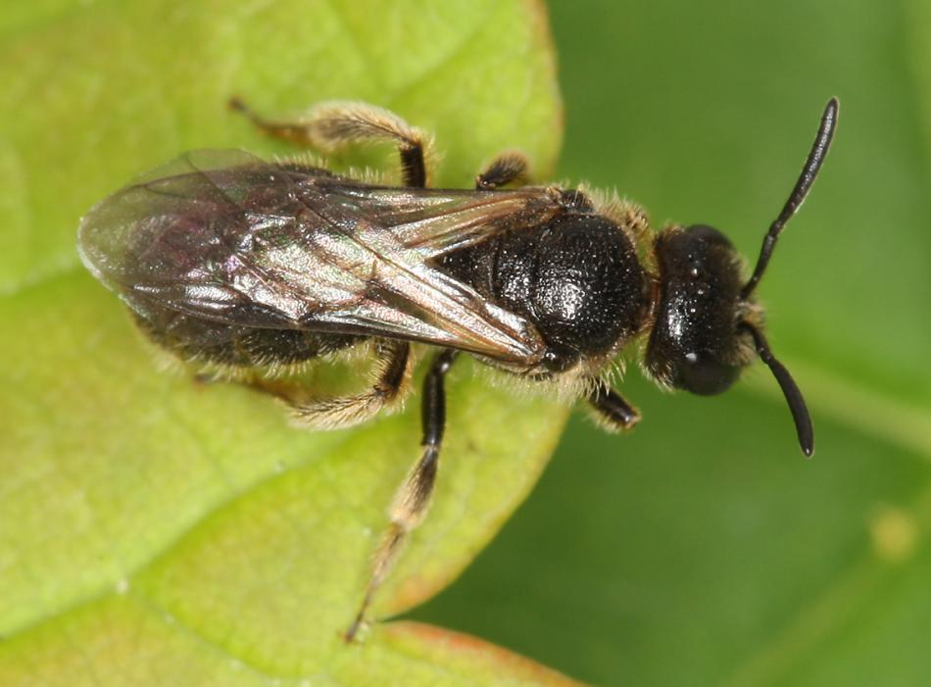
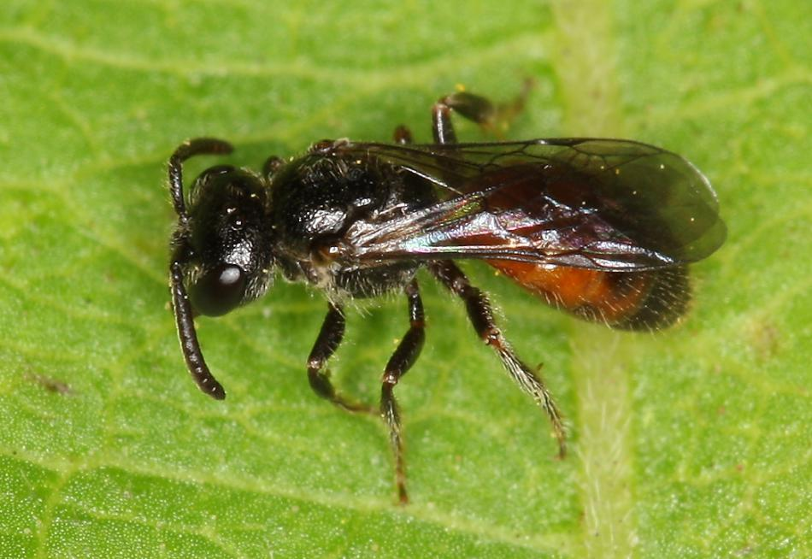
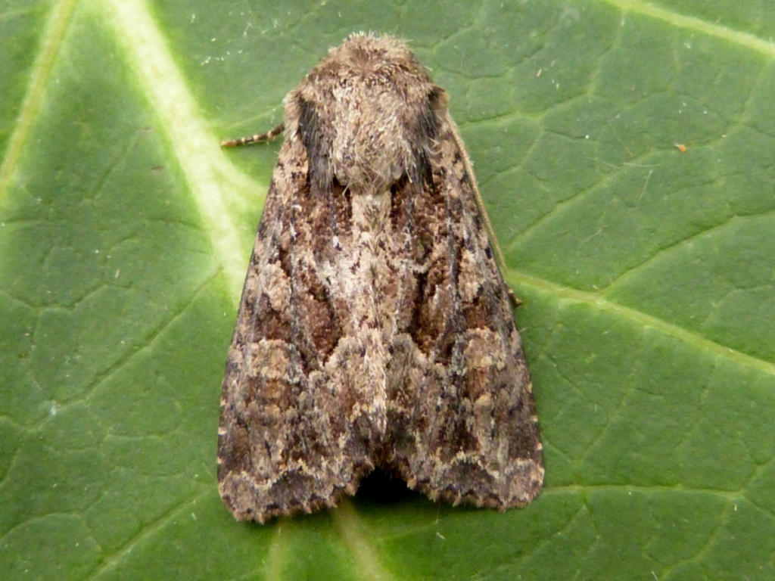
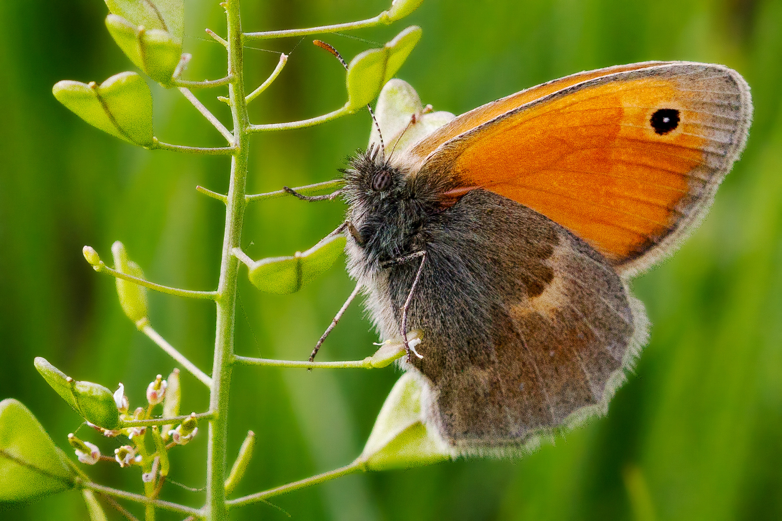
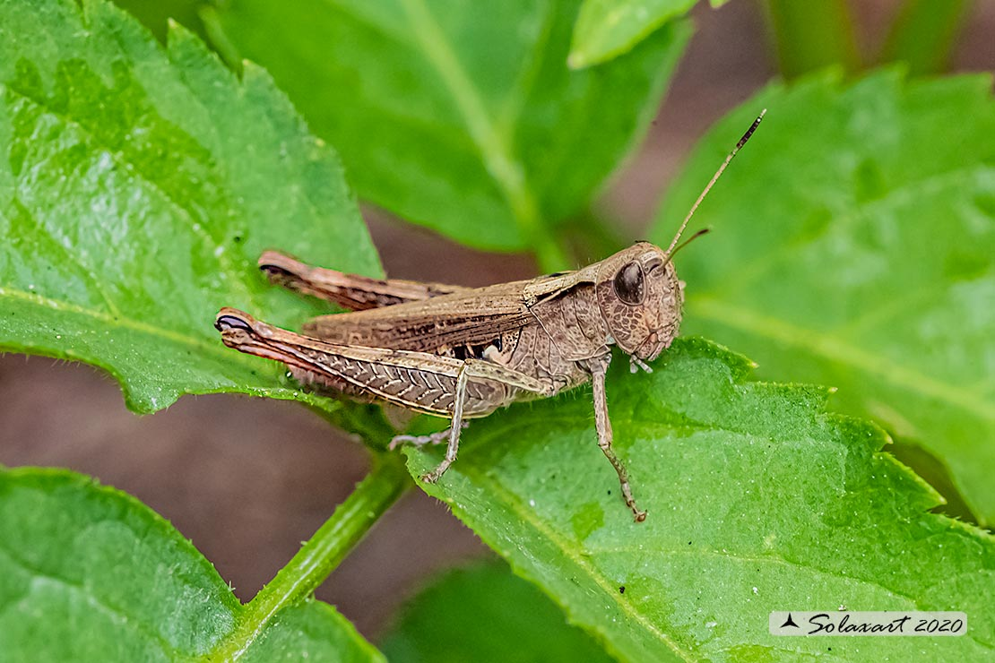
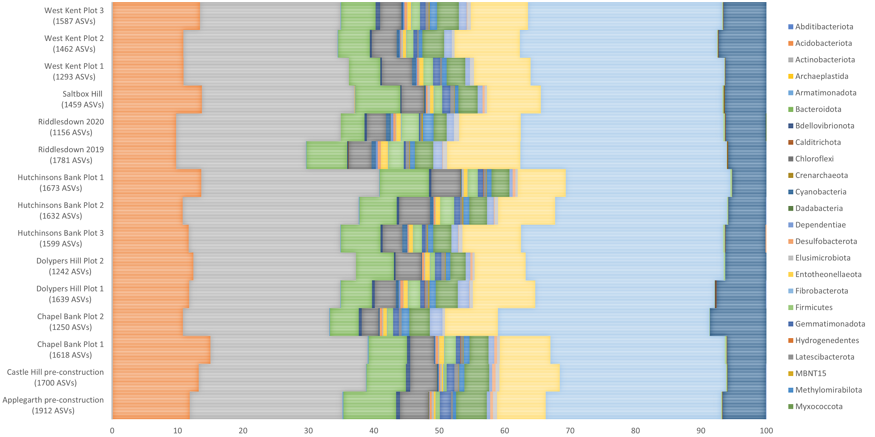
Testing eDNA and acoustic methods at partner sites (Glasgow, Newcastle, Cardiff, London) to investigate the impacts of nature recovery actions
Notes:
And we’re working with partners across the UK to study urban sites using eDNA and acoustics – variation, similarity, how to communicate what are in effect black-box scineces to non-expert audiences and conservation land managers- what is of interest to them, how to share and package results

Slide 15
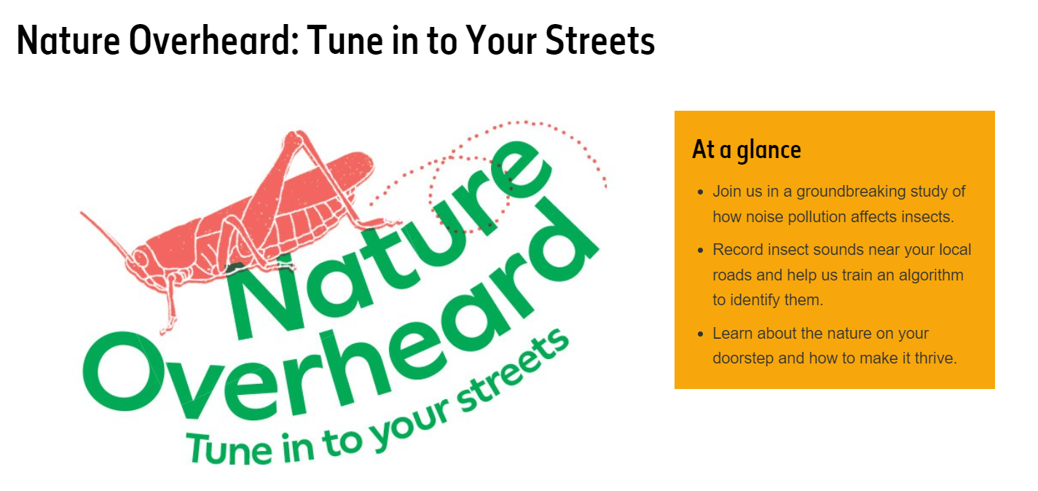
“How does noise pollution from roads affect insects?”
Notes:
Another example of how we’re building on our on-site research is community or participative science
Here where we’re actively using digital tech to connect people with their local urban nature and engage audiences in scientific research using a familiar device – their mobile phone.
Open to all, but aims to empower young people by focusing on their interests, curiosity and concerns – co-designed with school pupils “How can we make roads better for nature?”
Human-made noise can cause behavioural and physiological changes in animals
First study to look at impact of road noise on insects - at scale - in the UK
56,000 participants in activities in 2023

Slide 16
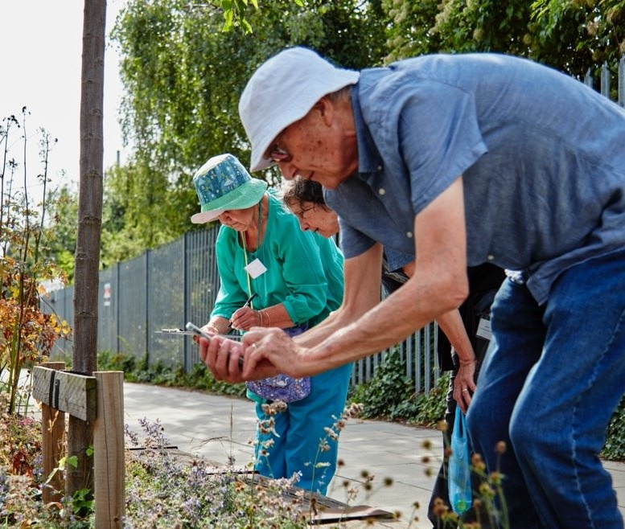
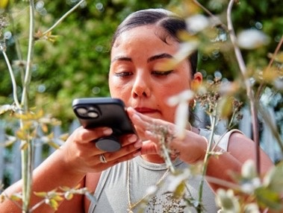
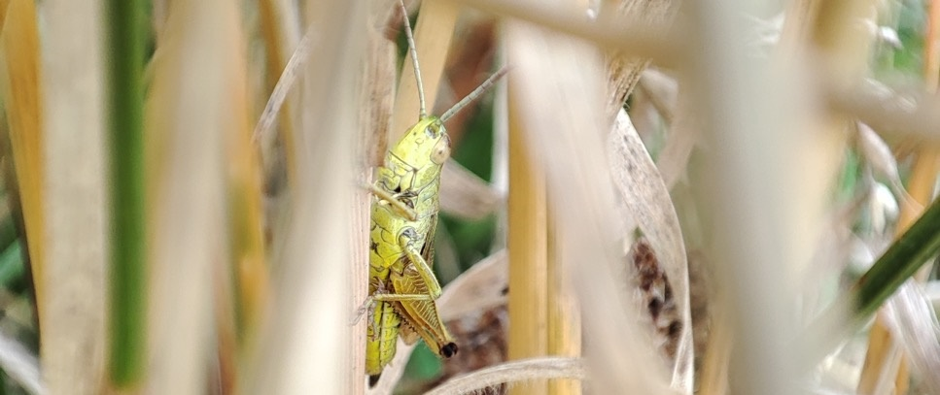
Select a 10m x 2m study area
Insect survey plus 5 minutes of audio
Upload data to project website
Using AI to recognise patterns
Insect behavioural change?
© James McNish
Notes:
Talk through how it works at a practical level

Slide 17
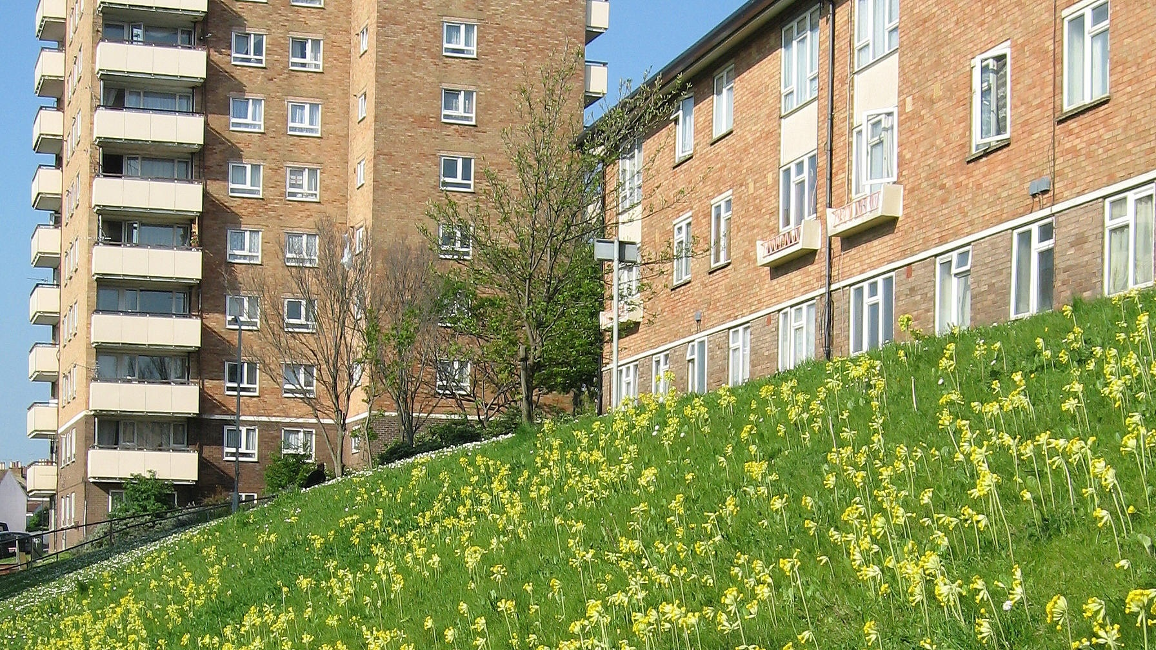
Supporting nature recovery action by building and communicating a holistic view of urban biodiversity presents a large-scale data challenge
Image © London Wildlife Trust
Notes:
And this leads us to a key challenge – we have the scientific tools – next gen monitoring that yields huge volumes of data of different types – but there is a data challenge
The data challenge: capturing, combining and sharing multiple data types from multiple locations, from and to a wide range of stakeholders, at scale.

Slide 18
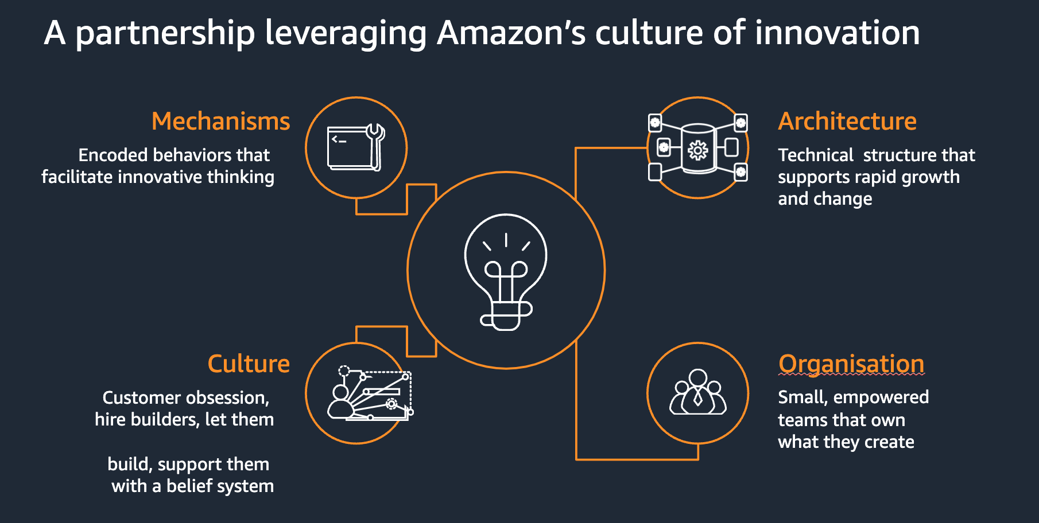

Slide 19
The Data Ecosystem
Notes:
Um because all of the different initiatives, whether it's researchers um that are part of the museum, whether it's the public and whether it's partner sites, etcetera. Um They bring with them a variety of different data sources, right? Um I mentioned E DNA um acoustic data observation data and so on. So, having a platform for all of this data was the challenge which leads us to speak about the data ecosystem, which essentially is the data layer that underpins and supports all of those urban nature project initiatives.

Slide 20
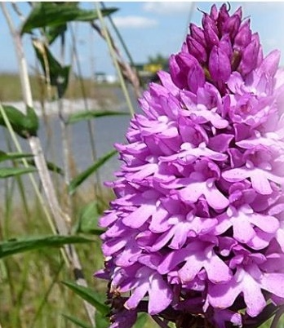
Introduction to the Data Ecosystem
An extensible platform to capture, store, curate and validate relevant data for wildlife observations
A single source of truth for biodiversity data
Automating taxonomy validations to help scientists manage data quality at scale
Notes:
We wanted to build an extensible platform (an ecosystem of tools) that facilitates the capturing, storing, curating, and validating for onward use visual and environmental DNA-based observations of plants and wildlife, as well as environmental and acoustic monitoring data from a high spatial resolution sensor network in the museum’s gardens.
“A single source of truth for our biodiversity data”
Never done before; previous projects were smaller-scale and standalone, for specific needs and data types. It was difficult to bring the data together in a way for researchers to exploit easily.
This enables the museum’s scientists to build scientific evidence of the impacts that habitat creation, restoration, and translocation have on the UK’s urban wildlife, from grassland to pond habitats. The gardens will be open to the public next year.
We now have a scalable platform with the data captured consistently.
We have all the data together; geo-stamped, timestamped for ease of correlation.
We have included automation of validation of taxonomies to help scientists manage data quality at greater scale.
Um The museum really wanted to build an extensible platform. So an ecosystem of tools that facilitated, you know, capturing, storing, curating and validating for onward use, essentially visual and environmental DNA based observations of plants and wildlife, as well as um say environmental and acoustic monitoring data from the high spatial resolution sensor network in the gardens that they're redeveloping. And really they wanted to build a single source of truth for different types of biodiversity data. It's never been done before really. Um previous projects were either much smaller scale or stand alone or for specific needs and data types. And actually, Carson is going to touch on one of these projects that has a very specific need and data type later. And their challenge really was bringing together the data in a way that researchers could very easily exploit and doing this would enable say the museum scientists to build scientific evidence of the impacts of habitat creation or restoration or translocation very quickly, essentially.

Slide 21
Different kinds of wildlife observation
Notes:
With the Data EcoSystem, there was a multitude of types of data, including visual observations but also the likes of Enviromental DNA
Environmental DNA looks at the organic matter surrounding the environment of an organism. As, in any environmental sample, there are remnants of other organisms such as dead skin cells, faeces, mucus and so on.
Environmental DNA (eDNA) allows us to consider the whole diversity of life, including extremely species-rich groups such as invertebrates and rarer species that may be overlooked by conventional surveys.
Acoustic measurements, like that recorded for the Nature Overheard can be sounds that we hear around the environment of a given organism
And visual observations are sightings of wildlife by scientists, researchers and the community in specific geographic locations.
This is all fed into the DE and can be used for a variety of different purposes
So this is sort of um at a at a high level, at a conceptual level what it looks like. So you have say on the left hand side, as I mentioned, the likes of environmental DNA. So I did promise that I'd define what this is. And so environmental DNA essentially looks at the organic matter surrounding the environment of an organism. So if you think about any environmental sample, right? So you can see uh where a particular worm was, for example, in, in a location in in its habitat, environmental DNA. Um not only looks at the um the specimen itself, but it also considers the whole diversity of life including um say species rich groups such as invertebrates, etcetera. And really what it does is it looks at that environmental sample to see whether there are remnants of other organisms such as dead skin cells, uh such as *** or mucus or so on. And this allows us to get a much better picture of some of those rarer species that might have been overlooked by conventional surveys. Um Then we have, as I mentioned uh acoustic data and then visual observations as well. So that's, that's a sighting essentially if you see a particular animal or plant in a particular location, you can record and say, OK, I saw this particular, um I saw a rhino in the park, for example, um a little bit unlikely, but you know, you can record it if it happened to. So the idea is that with that data ecosystem, uh this can be fed in and used for a variety of different purposes, whether it's the, the museum's researchers, whether it's the general public, um the wider scientific community and so on.

Slide 22
AWS Architecture: Data Plane
Notes:
From a data derivation and analysis perspective, a Lambda function sends DocumentDB events via Kinesis Firehose to an S3 bucket. From there, a Glue Spark job is triggered and the outputs stored back into Amazon S3
The Sagemaker notebooks here are for R Studio that will be used by the scientists to utilize the data collected by DE
Worth mentioning here that Vaticle’s TypeDB is used for Taxonomic equivalence as well (making sure the DE can take data from disparate sources and create this ‘common source of truth’ for all biodiversity data.
And then from a data derivation and analysis perspective, we have LAMBDA which sends document DB events via kinesis firehose to an S3 bucket. And from there um a glue spark job is triggered and the outputs are stored back into S3. Um We then have Sage Baker notebooks for our studio that be used or for, for um for uh notebooks as well essentially, that will be used by scientists to utilize the notebook. Sorry, it will be used by scientists to utilize some things like um uh the data collected by the data ecosystem and to perform um taxonomic equivalents and and so on

Slide 23






How AWS has uniquely helped
Understanding of changes to the UK’s urban nature
Develop new indices to monitor biodiversity.
Long-term urban biodiversity monitoring
Develop, test and refine new technologies
used by the conservation sector
Share data with researchers, land managers & government.
Inform conservation land management decisions.
Influence UK biodiversity policy.
AWS Fargate : Taxonomic Equivalence Engine, community science and observations applications.
AWS Lambda : Audio file uploads and sample processing.
AWS Glue : Pipelines for data ingestion and integration from different sources.
API for the Taxonomic Equivalence Engine
Data model and API for raspberry pi devices
Notes:
We’ve had a few major releases supporting research projects within UNP.
They have all focused on data collection – we can’t enrich or share data if we don’t collect it to begin with.
Our focus has been on gathering data and improving systems to enable us to scale. Gardens open in summer therefore there will be a lot more biological recording activity. A lot of recent work has been behind the scenes improving data architecture etc.
This leads nicely into how cloud has helped with this
With serverless technology, resources are scaled automatically on demand, ensuring efficient and cost-effective scalability. Some examples of AWS services used are:
AWS Fargate: TEE, community science and observations applications.
AWS Lambda: audio file uploads and sample processing.
AWS Glue: Pipelines for data ingestion and integration from different sources.
Serverless has been quite beneficial from a cost perspective as traffic is expected to pick up as the platform develops.
We’ve released an API for the Taxonomic Equivalence Engine created by Thoughtworks. This is used to determine standard species names from different databases in the eDNA data. So far 4,717 unique species have been searched in TEE with over 17,000 matches being made in 50,000 detections.
We have released a data model and API recently, for raspberry pi devices to upload audio recordings and environmental data like temperature/humidity. The raspberry pi devices are set to record circa 7GB of audio data a day. We can ingest this data into the DE continuously utilising AWS Lambda, forecasting upwards of 2TB of audio data in a year.

Slide 24
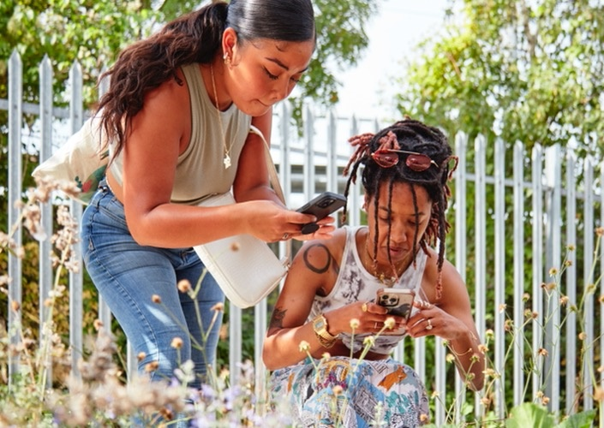
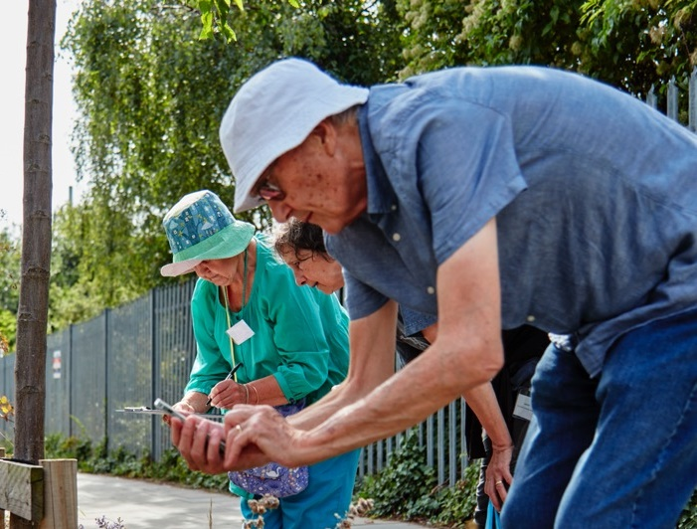
Get involved!
Visit our new gardens (from late July)
Test your tech at our site
Participate in Nature Overheard
Join our new Urban Nature Network https://the-urban-nature-network.mn.co/

Slide 25
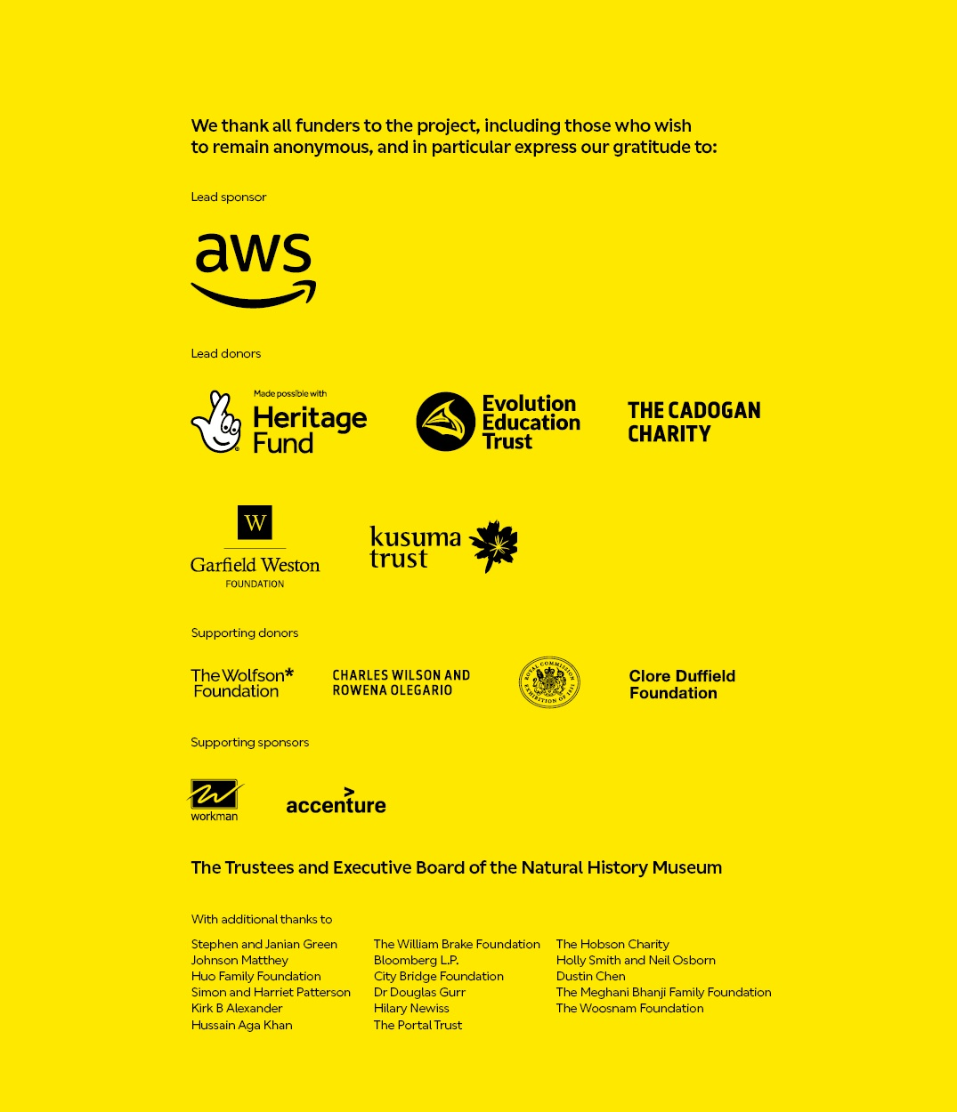
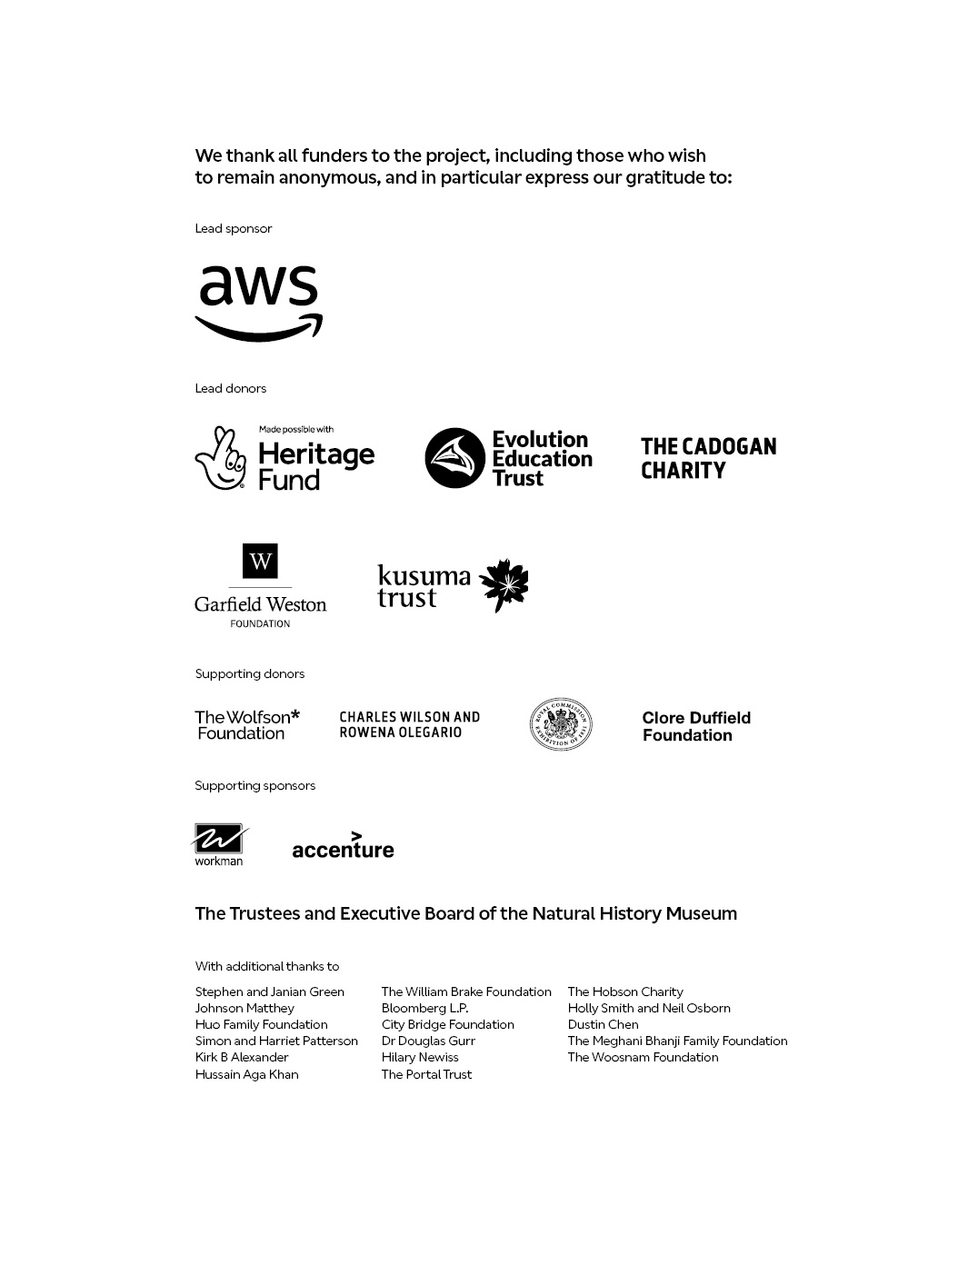
“The future of the natural world, on which we all depend, is in our hands”
Sir David Attenborough
j.tweddle@nhm.ac.uk
edward.baker@nhm.ac.uk

